Slide 1


SOEN 6431 Software Maintenance and Program Comprehension
Week 8:
Impact Analysis and Regression Testing

Slide 2

Characteristics of change
Software requirements change to accommodate user expectations, new environments etc.
potential high impact
invalidate assumptions
may change system design
Long development cycles
few people stay with the project
initial requirements or their rationale forgotten
Large teams, multiple version/ configurations

Slide 3
General Idea Change Impact
The maintenance process starts by performing impact analysis.
Impact analysis basically refers to identifying the components that are impacted by the Change Request (CR).
Impact of the changes are analyzed for the following reasons:
to estimate the cost of executing the change request.
to determine whether some critical portions of the system are going to be impacted due to the requested change.
to record the history of change related information for future evaluation of changes.
to understand how items of change are related to the structure of the software.
to determine the portions of the software that need to be subjected to regression testing after a change is effected.

Slide 4
General Idea - Traceability
Implementation of change requests impact all kinds of artifacts, including the source code, requirements, design documentation, and test scenarios.
Therefore, impact analysis traceability information can be used in performing impact analysis.
Gotel and Finkkelstein define traceability as the ability to describe and follow the life of an artifact in both the forward and backward directions.
Traceability helps software developers understand the relationships among all the software artifacts in a project.

Slide 5
General Idea – Ripple Effect Analysis
A topic related to impact analysis is ripple effect analysis.
Ripple effect means that a modification to a single variable may require several parts of the software system to be modified.
Analysis of ripple effect reveals what and where changes are occurring.
(i) between successive versions of the same system, measurement of ripple effect will tell us how the software’s complexity has changed.
(ii) measurement of ripple effect can tell us how the software’s complexity has changed because of the addition of the new module.

Slide 6
Concepts and terms
Impact analysis: identifying the potential consequences (impacts) of a change, or estimating what needs to be modified to accomplish a change
A side effect is an error or other undesirable behavior that occurs as the result of a change
Ripple effect: Small change to a system affects many other parts of it
Involves transitive closure
Ripple effect analysis emphasis changes of source code
Other ripple effect types:
Requirements: operation of the system is influenced
Interface: changes in using module needed
Environment: new programming language or programming environment
Management and logistics: Impacts resources available, schedule, contracts, training, deployment

Slide 7
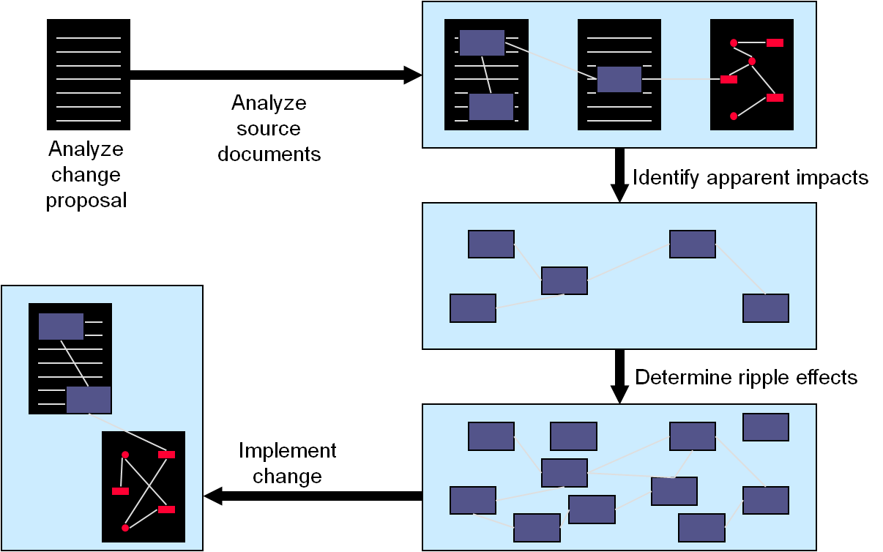
Impact-analysis process
Input: Set of software life-cycle objects (SLO)
Analyze SLOs with respect to the change
Output: List of items that should be addressed during the change process

Slide 8
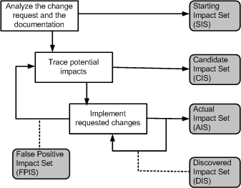
A more detailed look: Impact Analysis Process

Slide 9
Impact Analysis Process
Starting Impact Set (SIS): The initial set of objects (or components) presumed to be impacted by a software CR is called SIS.
Candidate Impact Set (CIS): The set of objects (or components) estimated to be impacted according to a certain impact analysis approach is called CIS.
Discovered Impact Set (DIS): DIS is defined as the set of new objects (or components), not contained in CIS, discovered to be impacted while implementing a CR.
Actual Impact Set (AIS): The set of objects (or components) actually changed as a result of performing a CR is denoted by AIS.
False Positive Impact Set (FPIS): FPIS is defined as the set of objects (or components) estimated to be impacted by an implementation of a CR but not actually impacted by the CR. Precisely, FPIS = (CIS U DIS) \ AIS.
where U denotes set union and \ denotes set difference.
In the process of impact analysis it is important to minimize the differences between AIS and CIS, by eliminating false positives and identifying true impacts.

Slide 10
Major areas
Dependency analysis
examining detailed dependency relationships among program entities (often: source code entities)
intra-product dependencies
often hard-coded into tools
Traceability analysis
relationship among all types of SLOs
inter-product dependencies
often: not very detailed

Slide 11
Identifying the Starting Impact Set (SIS)
There are several methods to identify concepts, or features, in source code.
The “grep” pattern matching utility available on most Unix systems and similar search tools are commonly used by programmers.
However, grep has some deficiencies:
it is based on the correspondence between the name for the concept assigned by the programmer and an identifier in the code.
The technique often fails when the concepts are hidden in the source code, or when the programmer fails to guess the program identifiers.

Slide 12
Identifying the Starting Impact Set (SIS)
The software reconnaissance methodology proposed by Wilde and Scully is based on the idea that some programming concepts are selectable, because their execution depends on a specific input sequence.
Selectable program concepts are known as features. By executing a program twice, one can often find the source code implementing the features:
(i) execute the program once with a feature and once without the feature.
(ii) mark portions of the source code that were executed the first time but not the second time.
(iii) the marked code are likely to be in or close to the code implementing the particular feature.

Slide 13
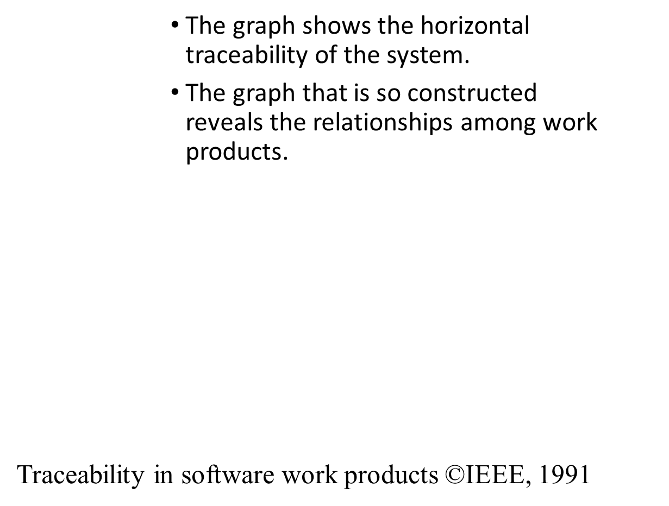
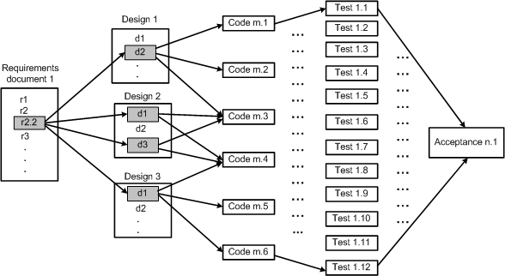
Analysis of Traceability Graphs

Slide 14
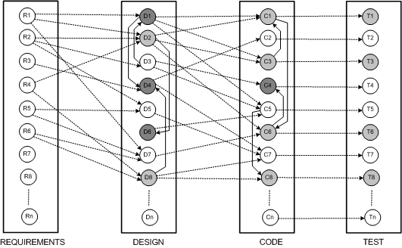
Analysis of Traceability Graphs
The graph has four categories of nodes: requirements, design, code, and test.
The edges within a silo represent vertical traceability for the kind of work product represented by the silo.
Traceability in software work products ©IEEE, 1991

Slide 15
Video

Slide 16
Identify the Candidate Impact Set (CIS)
A CIS is identified in the next step of the impact analysis process.
The SIS is augmented with software lifecycle objects (SLOs) that are likely to change because of changes in the elements of the SIS.
Changes in one part of the software system may have direct impacts or indirect impacts on other parts.
Both direct impact and indirect impact are explained in the following.
Direct impact: A direct impact relation exists between two entities, if the two entities are related by a fan-in and/or fan-out relation.
Indirect impact: If an entity A directly impacts another entity B and B directly impacts a third entity C, then we can say that A indirectly impacts C.

Slide 17
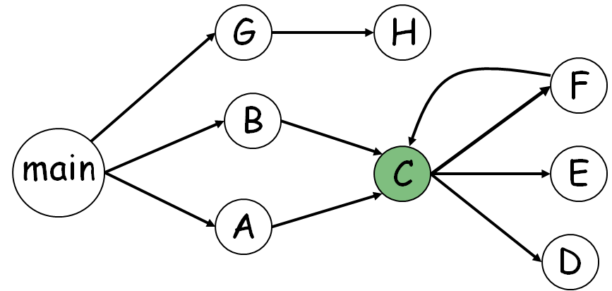
Call-Graph Based Approach
Objective:
If I change function C, what other functions could be affected (impacted)?
Depends on analysis of source code
Based on assumptions of all possible software runtime behaviors
Results can include most of the software system in the impact set
The call graph-based approach to impact analysis suffers from many disadvantages as follows:
Impact analysis based on call graphs can produce an imprecise impact set. For example (Figure) one cannot determine the conditions that cause impacts of changes to propagate from M to other procedures.
Impact propagations due to procedure returns are not captured in the call graph-based technique. Suppose that, in Figure, E is modified and control returns to C.. Now, following the return to C, it cannot be inferred whether impacts of changing E propagates into none, both, A or B.

Slide 18
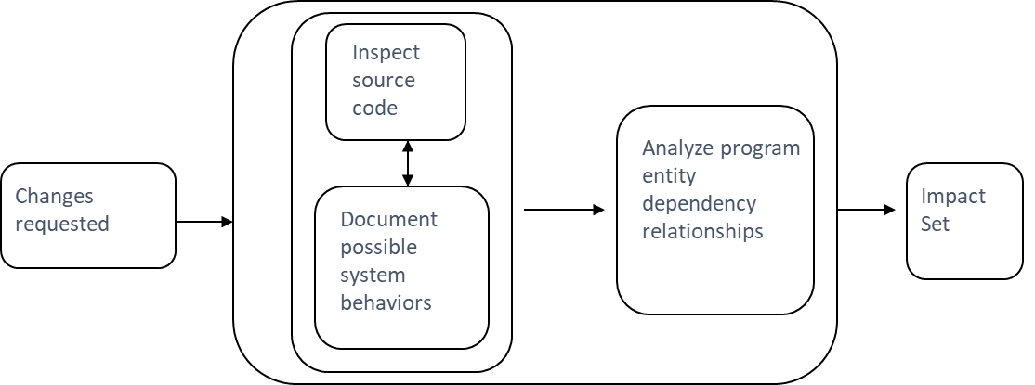
Static Impact Analysis
Perform analysis on source code
Call graph traversals
Slicing
Obtain conservative results
Accounts for all possible inputs and behaviors
Can give very large impact sets
E.g., Static Forward slicing !

Slide 19
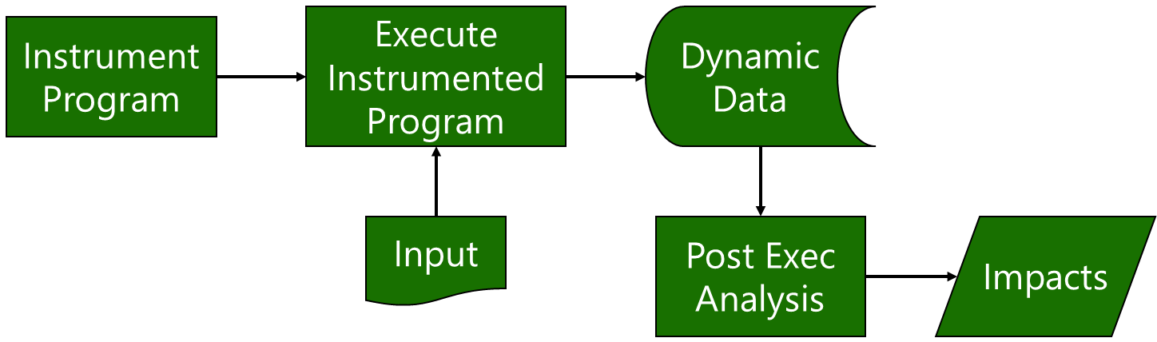
Dynamic Impact Analysis
Not as conservative -- results depend on input
Give impacts related to program use

Slide 20
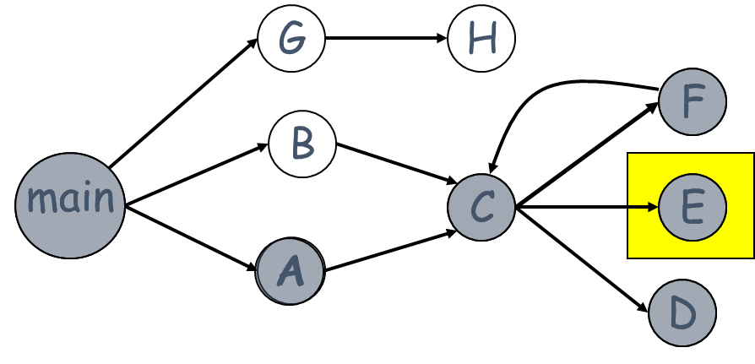
Example
Let us consider an execution trace as shown in below.
M B r A C D r E r r r r x. Where r and x represent function returns and program exits.
The impact of the modification of M with respect to the given trace is computed by forward searching in the trace to find:
procedures that are indirectly or directly invoked by E; and
procedures that are invoked after E terminates.
One can identify the procedures into which E returns by performing backward search in the given trace.
For example, in the given trace, E does not invoke other entities, but it returns into M, A, and C.
Due to a modification in E, the set of potentially impacted procedures is {M,A,C, E}.

Slide 21
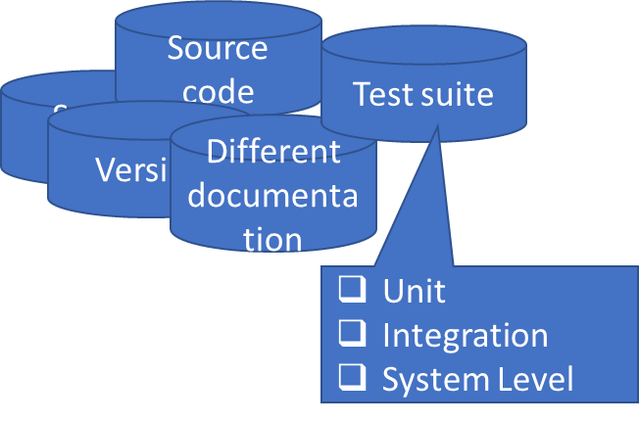
Review
Identify starting point of the change => E
Identify impacted code and other artifacts (static, dynamic)
Implement the actual change => Module E, C, F…?
Re-test – what should we be re-testing and what would be the purpose of re-testing?

Slide 22
Software Regression Testing
What is Software Regression Testing?
Basic Software Regression Problems
Software Regression Testing Process
Regression Strategies for Traditional Software
Basic Solutions to Software Regression Problems
Regression Strategies for Object-Oriented Software

Slide 23
What is Software Regression Testing?
What is Software Regression Testing?
Testing activities occur after software changes.
Regression testing usually refers to testing activities during software maintenance phase.
Major testing objectives:
Retest changed components (or parts)
Check the affected parts (or components)
Regression testing at different levels:
Regression testing at the unit level
Re-integration
Regression testing at the function level
Regression testing at the system level

Slide 24
Who performs software Regression:
Developers - regression testing at the unit level or integration
Test engineers - regression testing at the function level
QA and test engineers - regression testing at the system level
What do you need to perform software regression testing?
Software change information (change notes).
Updated software REQ and Design specifications, and user manuals.
Software regression testing process and strategy.
Software regression testing methods and criteria.
What is Software Regression Testing?

Slide 25
What Is Regression Testing?
A system under test (SUT) is said to regress if
A modified component fails, or
A new component, when used with unchanged components, causes failures in the unchanged components by generating side effects or feature interactions.
Baseline version
The version of a component (system) that has passed a test suite.
Delta version
A changed version that has not passed a regression test

Slide 26
What Is Regression Testing? - cont
Delta build
An executable configuration of the SUT that contains all the delta and baseline components
Regression test case
A test case that the baseline has passed and which is expected to pass when rerun on a delta build
Regression test suite
A set of regression test cases
Regression fault
A fault revealed by a test case that has previously passed but no long passes

Slide 27
Challenges in Software Regression Testing
Major challenges in software regression testing:
How to identify software changes in a systematic way? - REQ. specification changes - Design specification changes - Implementation (or source code) changes - User manual changes - Environment or technology changes - Test changes
How to identify software change impacts in a systematic way? - REQ impacts - Design impacts - Implementation impacts - User impacts - Test impacts
How to minimize re-testing efforts, and achieve the adequate testing coverage?

Slide 28
When Is Regression Testing Done?
During software maintenance
Corrective maintenance – changes made to correct a system after a failure has been observed (usually after general release)
Adaptive maintenance – changes made to achieve continuing compatibility with the target environment or other systems.
Perfective maintenance – changes designed to improve or add capabilities.
Preventive maintenance – changes made to increase robustness, maintainability, portability, and other features.

Slide 29
Software Regression Process
Software Regression Process:
Step #1: Software Change Analysis Understand and analyze various software changes.
Step #2: Software Change Impact Analysis Understand and analyze software change impacts
Step #3: Define Regression Test Strategy and Criteria
Step #4: Define, select, and reuse test cases to form a regression test suite
Step #5: Perform re-testing at the different levels. - re-testing at the unit level - re-testing at integration level - re-testing at the function level - re-testing at the system level
Step #6: Report and analyze regression test results

Slide 30

Software Regression Strategy
What is a software Regression strategy?
Software test strategy provides the basic strategy and guidelines to test engineers to perform software regression testing activities in a rational way.
Software Regression strategy usually refers to a rational way to define regression testing scope, coverage criteria, re-testing sequence (or order) and re-integration orders.
Software regression test models are needed to support the definition of software regression test strategy, test cases, and coverage criteria.

Slide 31
How Is Regression Testing Done?
Remove broken test cases from the original test suite;
A broken test case is one that cannot run on the delta build.
Choose a full regression test suite or a reduced regression test suite
Set up the test configuration;
Run the (reduced) regression test suite;
Take appropriate action for no pass tests;

Slide 32
Automation: Required Capabilities
Version control
The test suites and the SUT must be under configuration management control
Modular structure
Baseline test suites grow with successive increments and releases.
Organizing test suites into small modules facilitates selection and maintenance of tests.
Compare baseline and delta results

Slide 33
Automation: Required Capabilities – cont.
Smart comparator
The ability to ignore some output fields (e.g. time stamps) while comparing expected and actual results.
Shuffling
Automatically shuffles the order of the test suite , in order to reveal sequence-sensitive bugs
Built-in test
Test drivers packaged with a component can reduce the cost of test maintenance

Slide 34

Automated Testing

Slide 35
Test Suite Maintenance
A regression suite can become large after several release cycles.
Additions and changes to the SUT call for corresponding changes in its test suite.
Test suite decay
Some tests simply fail to run due to code change
Tests may become obsolete as requirements change / evolve
If 1<=x<=1000 has changed to 1<=x<=10000, the baseline tests still pass, but do not probe the boundary
Redundant test cases can easily occur.
Testers are often reluctant to remove them because of the risk of throwing away a test that would reveal some current or future fault

Slide 36
Test Suite Maintenance - cont
How to avoid decay:
Pay close attention to decreases in coverage. Use missing coverage as a pointer to missing clues.
Insist on tests with variety and complexity.
Discard unnecessary tests

Slide 37
Reducing a Test Suite-Unsafe Reduction
Unsafe reduction
Can omit test cases that might reveal a regression bug
Systematic sampling
Select every n^{th} baseline test case automatically.
A simple way to control the scope of testing.
Random sampling
Select baseline test cases automatically so that, given n, each baseline case has a 1/n chance of being selected.
Almost produces a different test suite each time.
Coverage-based filtering
Coverage analyzers can identify tests that exercise the same components and offer this ability as a feature for reducing regression test suites.

Slide 38
Retest Risky Use Cases
Choose baseline tests to rerun by risk heuristics
Skip enough non-critical, low priority, or highly stable use cases to meet a deadline or budget constraint.
Risk criteria
Suspicious use cases – use cases that depend on components, middleware, or other resources that
are individually unstable or unproven;
have not been shown to work together before or are unstable;
implement complex business rules;
have a complex implementation (e.g. 10 times the code size of all other components), or
were subject to high churn during development.

Slide 39
Retest Risky Use Cases - cont
Risk criteria - cont
Critical use cases: select tests for use cases that are necessary for safe, effective operation.
For each case, try to identify the worst-case effects of failure.
Consequences
Moderate risk of missing a regression fault and generally a low cost of analysis and setup.
Known Use
Reducing test suites by focusing on risks and customer priorities is a common practice.

Slide 40
Retest Risky Use Cases - Consequences
Inclusiveness
Unsafe because of no analysis of dependencies
Precision
Some tests that could be skipped may be repeated
Efficiency
The time and cost are constrained.
Analysis can be done without code analyzers or in-depth technical knowledge of the SUT because selection is based on use cases.
Generality
Can be applied in nearly and circumstance and at any scope

Slide 41
Retest by Profile
Use a budget-constraint operational profile
Test strategy
Determine how many of the test cases can be run?
Average time needed to run each test case
Expected bug rate
Hopefully reduced, compared with that of the baseline testing
Average debugging time
Probably will not be reduced
Determine how many cases will be used for each use case
Distributed in proportion to the relative frequency of each use case - defined in profile.

Slide 42
How Many Test Cases Can Be Run? (Example)
Example: For an ATM system
Baseline test suite has 20,000 test cases.
6000 minutes (100 hours) available.
An average of 5 min to run one test case.
A test reveals a bug 0.5 percent of the time.
A bug fix requires 200 minutes.
How many test cases can we re-run within the given constraints?
5x+ (0.005x*205) = 6000
5x+1.025x = 6000
6.025x =6000
x ≅ 1000

Slide 43
Allocation of Regression Test Time
Use case | Probability | #Tests
Cash withdrawal | 0.53 | 2650
Checking deposit | 0.15 | 750
Savings deposit | 0.14 | 700
Funds transfer | 0.08 | 400
Balance inquiry | 0.06 | 300
Restock | 0.02 | 100
Collect deposit | 0.02 | 100
Total | 1 | 5000
By use case frequency

Slide 44
Retest by Profile – Consequence
Moderate risk of missing a regression fault
Inclusiveness
Unsafe
Precision
Some tests that could be skipped may be repeated
Efficiency
Time and cost to run the tests are constrained.
Done without code analyzers or in-depth knowledge of the SUT
Generality
Best suited to system scope testing of applications for which an accurate operational profile can be developed

Slide 45
Reducing a Test Suite Unsafe Reduction
Retest by profile
use a budget-constrained operational profile
e.g., all use cases are exercised and in the same relative frequency as the full test suite, but with fewer test per use case.
Retest risky use cases
use risk-based heuristic to select a partial suite
e.g., suspicion about which new components are likely to cause trouble or which components depend on some others.
…

Slide 46
Retest Within Firewall
Use code dependency analysis to select a partial test suite.
A firewall is a set of component whose test cases will be included in a regression test
Identified by analysis of changes to each component and its dependencies on other components
Contract change
Implementation change
Low risk of missing a regression fault.
The direct cost of analysis and setup can be low if the analysis is automated

Slide 47
A Module-Based Firewall Concept for Software Regression Testing: A module firewall refers to a changed software module and a closure of all possible affected modules and related integration links in a program based on a control-flow graph. With this firewall concept, we can reduce the software regression testing to a smaller scope →All modules and related integration links inside the firewall. This implies that:
re-test of the changed module and its affected modules
re-integration for all of related integration links
Similarly, we can come out different kinds of firewalls based on various test models.
data firewall, function firewall
class firewall, state/transaction firewall
Traditional Software Regression Strategy Based on The Firewall Concept

Slide 48
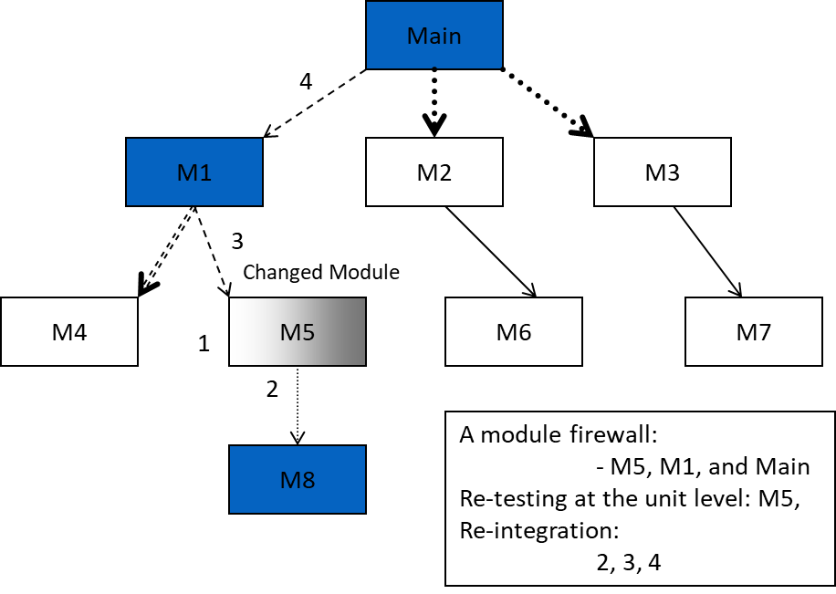
A Changed Module Firewall For Regression Testing

Slide 49
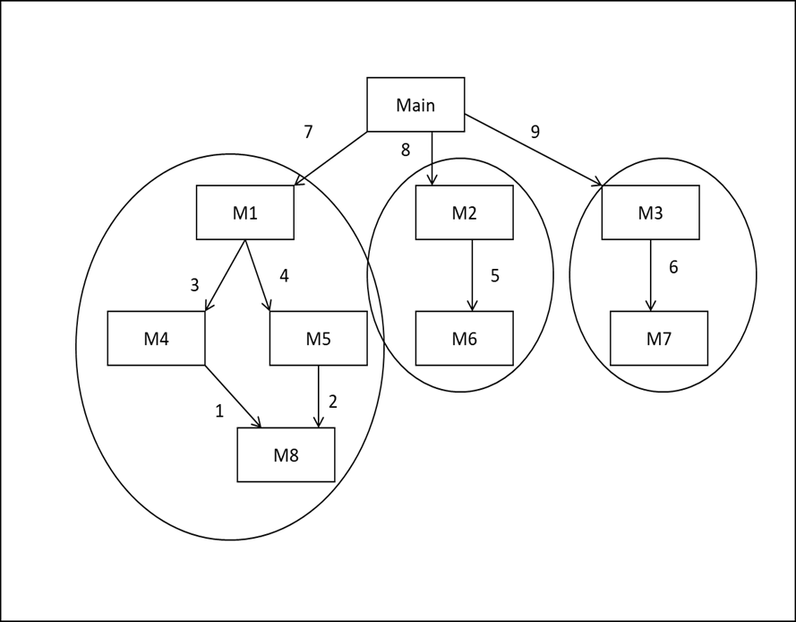
Example of Firewalls within a larger system

Slide 50
A class firewall concept in OO Software is very useful for OO regression testing.
What is a class firewall?
A class firewall is a closure set of all classes that are directly or indirectly dependent on the changed class in an OO program.
The class firewall provides the safe scope of regression testing for an OO software after changing a class(es).
Class Firewall Application:
With this class firewall concept, we can narrow down the class regression testing scope, including unit re-testing, and re-integration.
Based on the class firewall and changed information, we can select, define, and reuse class test cases for regression testing.
The Class Firewall Concept

Slide 51
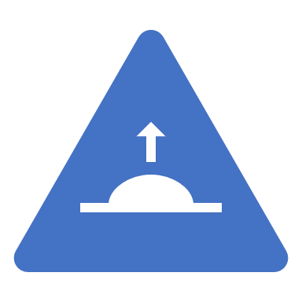
Retest Within Firewall - Consequences
Inclusiveness
Safe. Implicit dependencies are considered
Precision
A few tests that could be skipped may be included
Efficiency
In the worst case, the selection computation is on the order of the size of the baseline test suite times the number of components in the larger of the baseline or delta component.
It does not guarantee any particular time and cost deduction – constraints may not be met
Generality
Applicable at cluster scope. Requires the programmer to have skills in code analysis and related tool.

Slide 52
Providing Test Input
Hardwire test inputs into the test harness
Simply execute the test harness whenever you fix a bug in the class that is being tested
Place inputs on a file instead
Input redirection:
E.g. < test.in
Some IDEs do not support input redirection - use command window (shell).
Generate test inputs automatically
For few possible inputs, feasible to run through (representative) number of them with a loop
Generate test inputs randomly

Slide 53
Test Case Evaluation
How do you know whether the output is correct?
Calculate correct values by hand
For a payroll program, compute taxes manually
Supply test inputs for which you know the answer
square root of 4 is 2 and square root of 100 is 10
Verify that the output values fulfill certain properties
square root squared = original value
Use an Oracle
A reliable existing method to compute a result
E.g. Math.pow for x^{1/2}

Slide 54
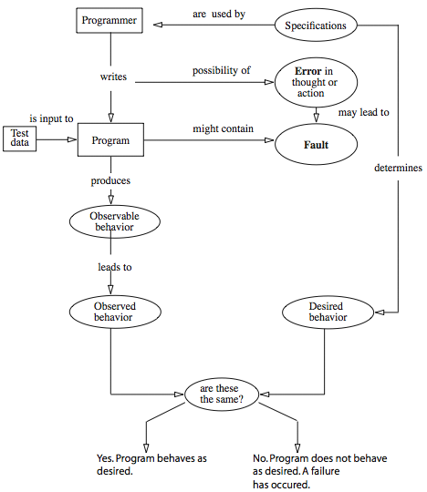
Programming, Faults & Testing

Slide 55
What Is Automated Testing?
Test automation is software that automates any aspect of testing an application system
Generate test inputs and expected results
Run test suites without manual intervention
Evaluate pass/no pass
Extent of automated testing depends on:
Testing goals and budget
Development process
Kind of application under development
Particulars of the development and target environment

Slide 56
Automated Testing: Advantages
Improved Productivity:
Repeatable tests
Long and complex tests
More time to design tests achieving greater coverage
The only repeatable and efficient way to evaluate a large quantity of output.
Quick and efficient verification of bug fixes
Consistent capture and analysis of test results
Reduced Costs
What about the cost of test automation?
It is typically recovered after two or three development cycles from increased productivity and the avoided costs with buggy software.

Slide 57
Automated Testing: Limitations
A skilled tester using knowledge of product features to improvise tests can be effective.
If no need to repeat the tests is evident, the cost of automation is probably not justified.
Test suites and harness must be maintained, which is no less difficult or expensive than maintaining application software.
Combining automated and manual testing is a common and effective practice.

